Slide 1
ITSC 200 – Network Protocols and Security
Network Devices

Slide 2
Today’s Objectives
To learn the function and roles of common network devices

Slide 3
What is a “Firewall” ?
The term “firewall” is a generic term that comes from the real world of construction and automotives.
In those worlds, a firewall is designed to resist the advancement of a fire for a specified period of time. It is not meant to stop the fire indefinitely.
As in the real world, we should not expect a firewall to always stop a determined intruder. We can expect it to slow them down.

Slide 4
Firewalls
Firewalls can be broadly separated into “stateful” and “stateless” firewalls.
The stateful firewalls will link incoming and outgoing related traffic to keep track of “conversations”.
A stateless firewall will treat each packet of a connection separately. It has no concept of a “conversation” or connection.
Obviously, the stateful firewalls are more intelligent when it comes to filtering traffic. They can single out traffic that claims to be part of a conversation but isn’t. But … they need to be more powerful (read “expensive”) to do that.

Slide 5
Firewalls
A common misconception is that a firewall alone will protect your network. Hackers call these networks “candy networks” … hard and crunchy on the outside, and soft and chewy on the inside.
Once a hacker gets passed the firewall on one of these networks, they have free access to the network.
Another very common problem is that network administrators concentrate on fine-tuning the ingress rules on a firewall but pay little attention to the egress rules of the firewall. Why is this a problem ?

Slide 6
Firewalls
A very common strategic military concept is the idea of a “choke point”. This is an narrow passage area where all traffic must pass through so is an ideal location to defend or inspect incoming and outgoing traffic.
A good example of this is the Dardanelles. Many people are familiar with the role that Sir Winston Churchill played during WWII as Prime Minister of Britain.

Slide 7
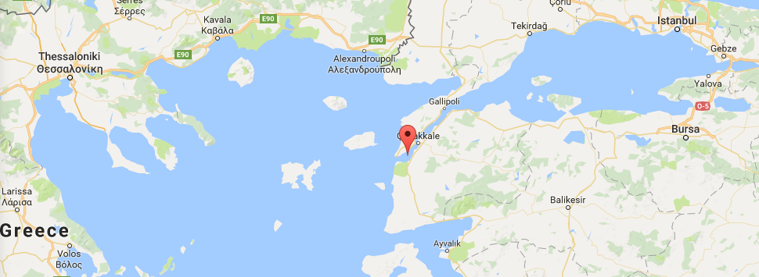
Choke Points
Most people are less familiar with his role in the WWI, where, as First Lord of the Admiralty, Churchill tried to take the Dardanelles with a fleet of British and French ships. It was a disaster.

Slide 8

Choke Points
You might be more familiar with the legendary Spartan last stand at the Battle of the Thermopylae…

Slide 9
Placement of Firewalls
Obviously, if a firewall is going to be used as a choke point, placement in the network is very important.
All ingress and egress traffic should be forced to use the firewall so there is one inspection point.
This is why rogue wireless routers are such a danger to networks. They provide additional entry and exit points to corporate networks.

Slide 10
The Role of a Firewall
Firewalls often assume the role of router as well as firewall. In many cases, a firewall can replace a router.
Firewalls usually do some sort of Network Address Translation (NAT) and often provide an end point for site-to-site VPN’s or client-to-site VPN’s.
In some cases, they may run additional software to act as proxy servers for any number of higher layer protocols like DNS, SMTP, and HTTP.

Slide 11
The Role of a Firewall
Firewalls may also have additional software to do intelligent inspection of application layer protocols so that they can do things like stop outgoing emails with attachments.
Most Linux distributions come with iptables or ufw.
ufw uses iptables.
Another very good, open-source firewall is Pfsense firewall. This firewall is based on FreeBSD, a UNIX derivative.

Slide 12
Iptables
Works with rules that rule the traffic on the machine.
By allowing or rejecting incoming and outgoing traffic.
Iptables is very complex, has a lot of functionality and you will learn a lot more about it in the rest of this course (and in practice).
Today, you will see a small fraction of what iptables can do.

Slide 13
Iptables
iptables –L
List all iptables chains and rules
Notice the three default chains: INPUT, FORWARD and OUTPUT
Notice also the default policy: ACCEPT.
That is called a TARGET.
We are interested in the ACCEPT and DROP targets.

Slide 14
Iptables
INPUT
Traffic that is destined to the machine.
Stuff that is coming in.
OUTPUT
Traffic that is going out of the machine.
Stuff that is going out.
FORWARD
Traffic that is being forwarded through the machine.

Slide 15
Iptables
iptables –P CHAIN TARGET
Changes the default policy for a chain.
Want to drop everything that comes to the machine?
iptables –P INPUT DROP
Want to drop everything that goes out of the machine?
iptables –P OUTPUT DROP

Slide 16
Iptables
iptables –A CHAIN –s <source> -d <dest> --sport <s.port> --dport <d.port> -j TARGET
Adds a rule to CHAIN that does TARGET on traffic from source:s.port to dest:d.port.
If you want to block traffic from sait.ca:
iptables -I INPUT -s www.facebook.com -j DROP
If you want to prevent anyone from accessing your website:
iptables -A INPUT -p tcp --dport 80 -j DROP

Slide 17
Iptables
iptables –F CHAIN
Removes all rules from a CHAIN.
If CHAIN is omitted, remove all rules from all chains.

Slide 18
Iptables
Playing with multiple hosts.
Spin two virtual machines.
Play with the INPUT and OUTPUT chains.

Slide 19
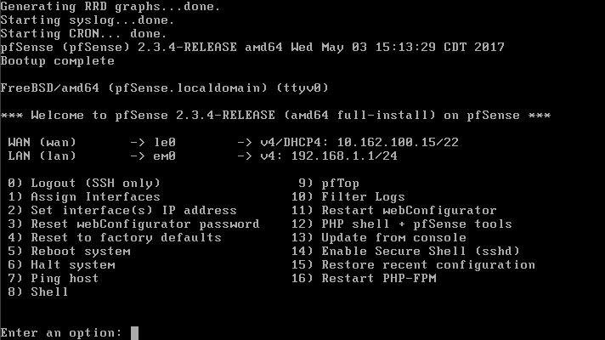
Pfsense

Slide 20
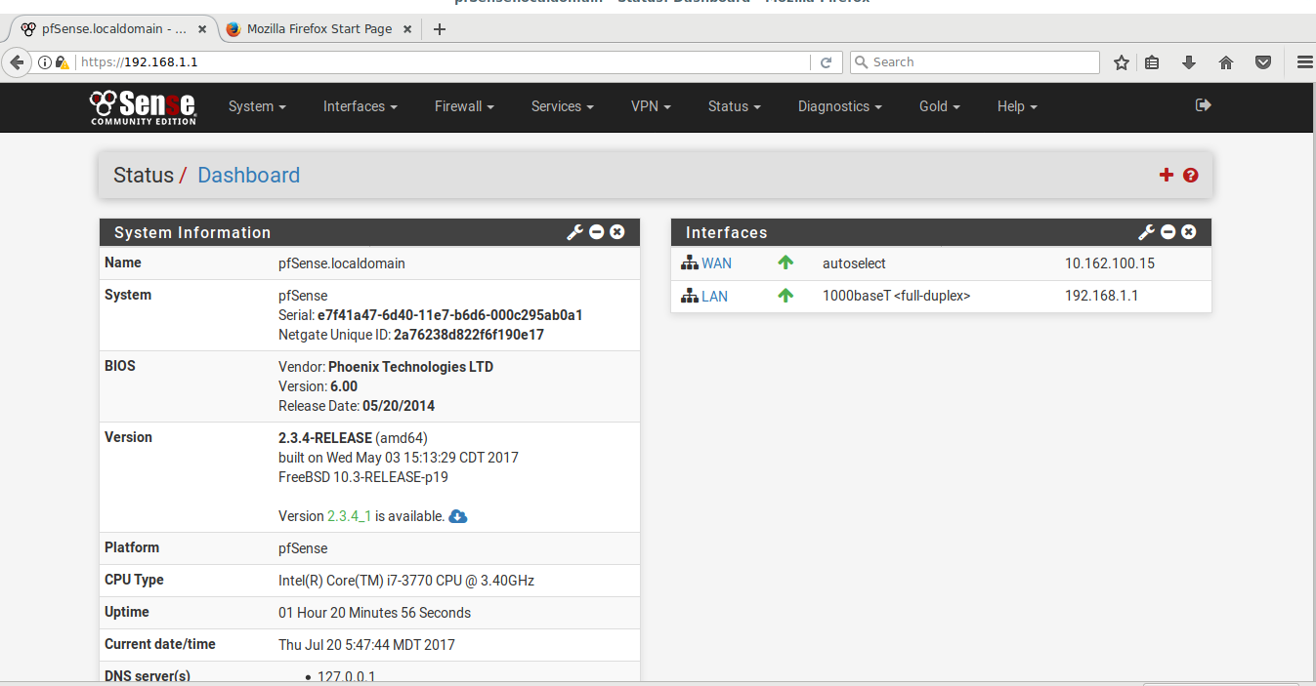
Pfsense

Slide 21
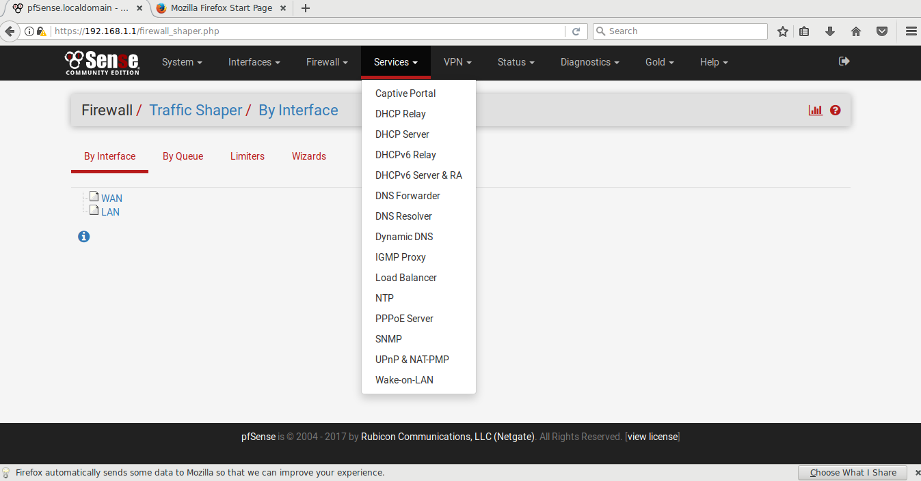
Pfsense

Slide 22
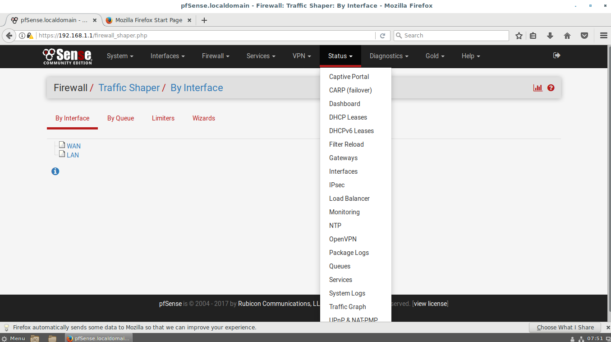
Pfsense

Slide 23
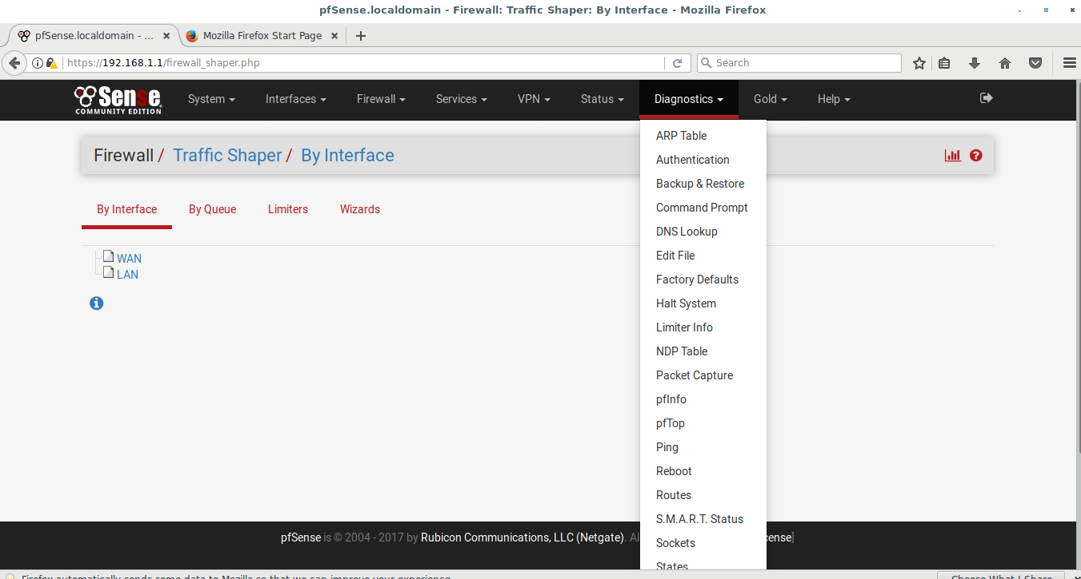
Pfsense

Slide 24
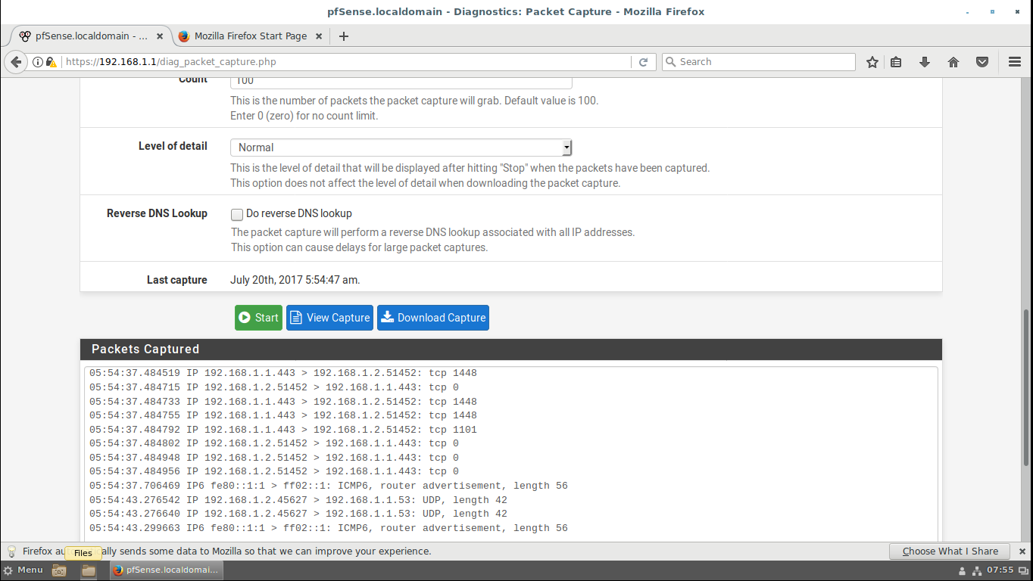
Pfsense

Slide 25

Coffee Break!

Slide 26
Load Balancers
Load balancers are specialized servers (or services) that act as a front end to a collection of servers (for instance web servers) and evenly distribute the requests to the servers so a single server is not overloaded.
Load balancers can be hardware-based or software-based and companies like Riverbed have specialized in this field.

Slide 27
Load Balancers
Many of the commercial load balancers have added extra features to their products, like intelligent traffic redirection and WAN optimization.
Load balancers allow companies to deploy 30 or 40 identical web servers to, simultaneously, service enormous traffic requests.
Facebook is coy about how many web servers it uses, but as of June 2010, Facebook’s presentations suggested at least 60,000 web servers.

Slide 28
Move to NFV and SDN
In the past three or four years, the networking industry has been aggressively moving to :
Network Function Virtualization (NFV)
Network functions like load balancing or routing are being handled by virtual devices instead of physical devices.
Software Defined Networking (SDN)
controller rather than having to configure indivNetworking configuration, including routing, vlans, and quality of service (QoS) are controlled by a centralized network idual switches and routers.

Slide 29
Lab
Download and complete lab 12

Slide 30
Welcome to the ISS program!

